Slide 1

Simulingua API
An API for Language Learning Services

Slide 2
Presentation Agenda
Learn about Simulingua
Explore the tech stack
Experience the Entity Relation Diagram
Go through the list of our API Functionalities
Appreciate our plans for the future
Observe the API in action

Slide 3
What is Simulingua?
Language Learning Social Network App
  Connects students
  Offers language-learning courses

Slide 4
Tech Stack
Microsoft SQL Server Database
.NET Framework
ADO.Net
Coded in C#
Written using Visual Studio
Tested via the Swagger interface

Slide 5
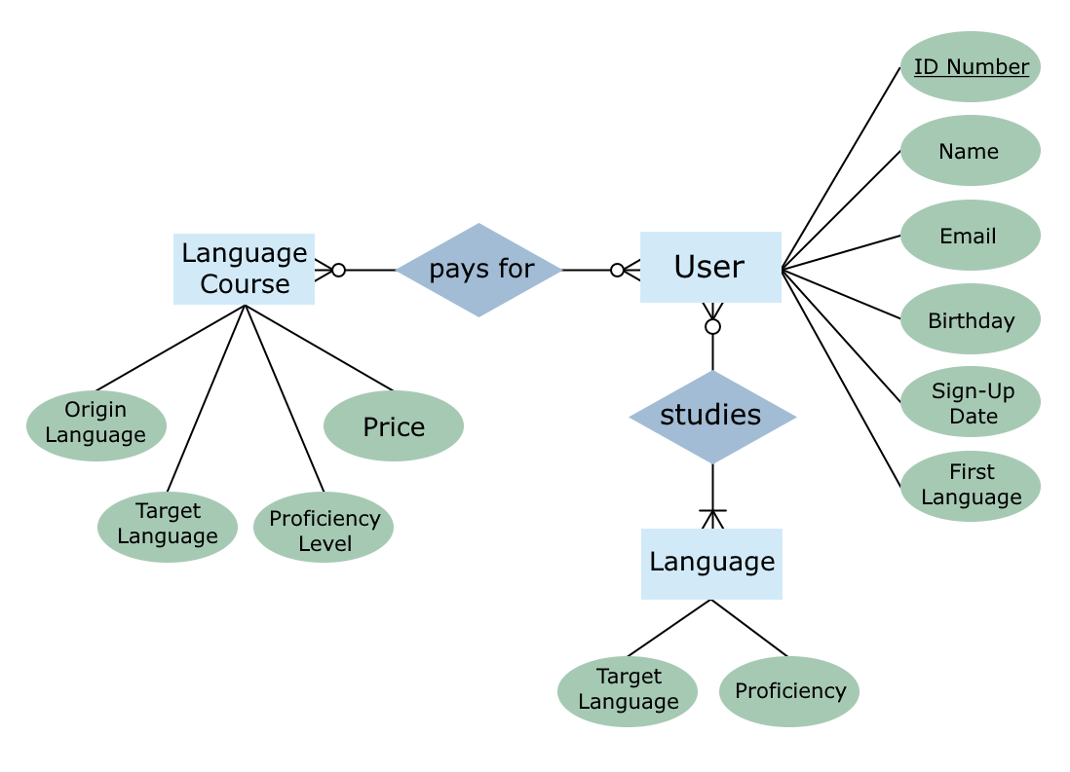
Entity Relation Diagram

Slide 6
API Functionality
Admin Commands:
  Add or remove language courses
  Adjust prices for existing courses
  View list of all users and user receipts
User Functions:
  Sign up with Email, Name, Birthday
  Add language goals to database
  Purchase language courses

Slide 7
Next Steps
Student-to-Student matching service
  Tutoring and group study
View (MVC)
  Drop-down list for language selection
  Tables to display lessons and prices
More extensive client-side validation
  Reduce possibility of SQL exceptions
Course Search, Recommend Courses
  Based on user language and proficiency

